Slide 1
Introduction to Radiation

Slide 2
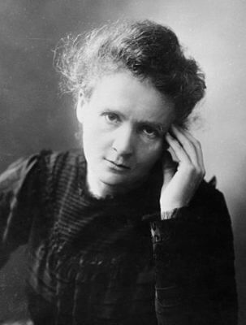
In this Smart Lesson you will learn to:
Differentiate between ionising and non-ionising radiation.
Understand the concept of background radiation.

Slide 3
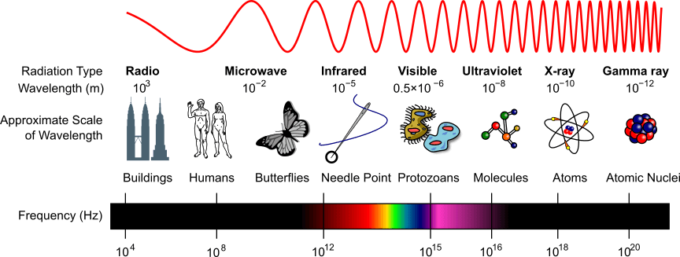
So what is radiation?
Radiation is defined as the emission of energy as electromagnetic waves or as moving subatomic particles, especially high-energy particles, which cause ionisation.

Slide 4
Radiation is either ionising or non-ionising.
Ionising radiation removes electrons from atoms, and results in the charge of the atom changing.

Slide 5
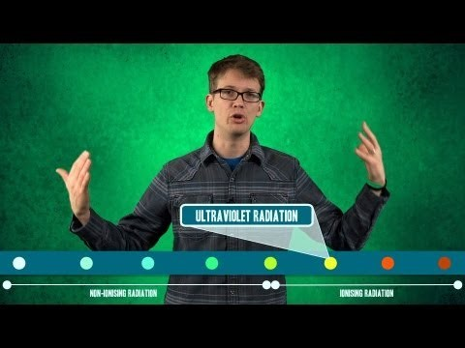

Slide 6
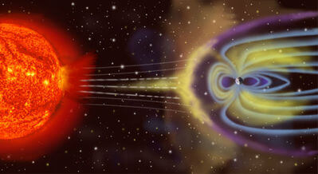
Ionising radiation is high energy.
Some examples include:
• | Gamma rays
• | X-rays
• | Ultraviolet Light
• | Cosmic rays
• | Alpha and Beta particles

Slide 7
Non-ionising radiation is low energy.
Some examples include:
Visible light
Infrared radiation
Microwave radiation
Radiowaves
Non-ionising radiation can still affect our bodies, even though they don't ionise atoms.

Slide 8
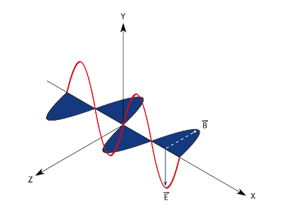
Electromagnetic radiation can be modelled either as a continuous wave or as if they're made up of massless particles called photons.
You may have noticed alpha and beta particles in the ionising list earlier. These are particles, not electromagnetic radiation.
We'll cover these more in the next lesson, but you need to know that these particles are emitted from radioactive decay and are highly energetic so they can ionise atoms.

Slide 9
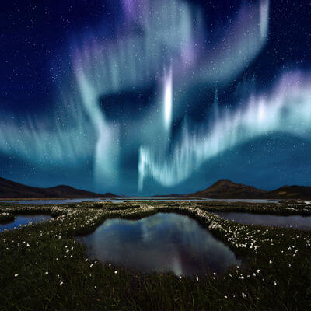
Background radiation is all around us.
It can be either cosmic or terrestrial.
Cosmic radiation comes from space. When protons interact with the Earth's atmosphere they cause cosmic showers of radiation. This can cause auroras!

Slide 10

Terrestrial radiation comes from the radioactive decay of elements in the Earth's crust.
Radioactive decay contributes to the temperature of the Earth. There are radioactive elements such as Uranium and Thorium in the Earth's mantle and crust. As these decay, they release large amounts of heat energy.
Radioactive chemicals in the soil can enter the food chain. The radioactive minerals may be absorbed by plants, which are then eaten by animals, passing along the radioactive materials.

